Slide 1


Slide 2
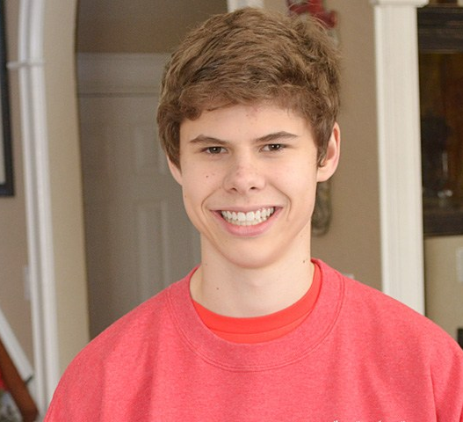
Introduction to David by Robert j. Gaudet, jr.

Slide 3
David’s law
Requires schools to investigate cyberbullying
Requires schools to report to parents of victims and bully.
Allows victims to get injunction against cyberbully.
Provides criminal penalties against cyberbullies who have intention for victim to be seriously hurt in physical way.
Prohibits cyberbullying in Texas schools, school buses, school activities or even outside school if it has an impact on learning environment

Slide 4
David’s Legacy foundation
Organization started by David’s mom, Maurine
Upon request by schools, provides presentations by volunteer lawyers to teach students about David’s Law
Matches victims and parents with volunteer lawyers who can send cease-and-desist letters & seek injunctions
Allows people to seek help by filling out form on website but it can take 20 minutes to find the right form
Does not have a mobile app

Slide 5
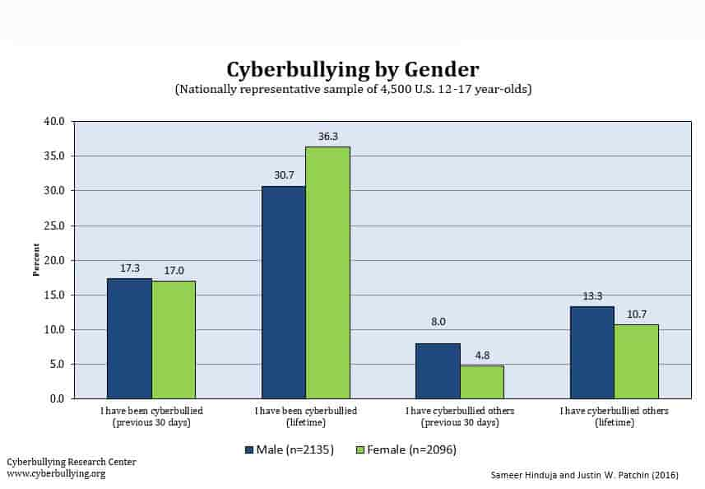
Cyberbullying endangers students by marisol beltran del rio

Slide 6
25% of kids admit they have experienced cyber bullying (source: www.mymobilewatchdog.com)
55% of kids recall daily occurrences of cyber-bullying (source: www.mymobilewatchdog.com)

Slide 7
Definition of cyberbullying:
Engaging in written or verbal expression, expression through electronic means, or physical conduct that occurs on school property, or in a vehicle that is operated by a district that:
(1) has the effect or will have the effect of physically harming a student, damaging a student's property, or placing a student in reasonable fear of harm to the student's person or of damage to the student's property; or
(2) is sufficiently severe, persistent, and pervasive enough that the action or threat creates an intimidating, threatening, or abusive educational environment for a student.
The Conduct described above is considered bullying if that conduct:
(1) exploits an imbalance of power between the student perpetrator and the student victim through written or verbal expression or physical conduct; and
(2) interferes with a student's education or substantially disrupts the operation of a school.
[source: https://www.texasprojectfirst.org/node/297]

Slide 8
The App by Nadide pasali
We invented PEACE app to help students or anyone who is 13 years old or older, to report cyberbullying.
Goal is to make it easy to report cyberbullying so that students can get help

Slide 9
The mobile app
Show the app
Demonstrate how It is used
Allows for reporting of cyberbullying and gathers pertinent information (name, number, description, uploading images, school, name of parent, severity of incidents)
Provides background information
Built by Nadide, Marisol, Rodrigo

Slide 10
AFTER SUBMISSION
Final message to user confirms information submitted
Says all info sent to David’s Legacy Foundation via email
if fear of bodily injury, person told info sent to law enforcement via email
If risk of hurting oneself, person given number for suicide prevention hotline

Slide 11
Next steps by patricia reyes
Finalize
Finalize technological parts of app
Confirm
Confirm David’s Legacy Foundation will accept data by email
Reach out
Reach out to law enforcement (police dept, sheriff’s offices, statewide law enforcement) to see if they will accept data on severe cases via email
Reach out
Reach out to prosecutors (County Attorney’s Offices, District Attorneys, Texas Attorney General) to see if they will accept data on serious cases via email

Slide 12
Educate students on how to use the mobile app
Ask David’s Legacy Foundation to make app a part of its presentations to high school students
Seek technological assistance to fix any bugs
Improve aesthetics
Create an Apple Iphone compatible version
Named PEACE: Protecting, Educating, Advocating, Celebrating, Empowering after the same slogan that is used by David’s Legacy Foundation

Slide 13
Thank you

